Slide 1

A Novel Methodology to Detect Frac Hits by Implementing Deep Learning and Distributed Data
Vu Nguyen

Slide 2
Objective: Develop deep learning algorithm to detect frac hits
Outlines:
Introduction
Data Acquisition/Data Wrangling
Data Visualization
Deep Learning Sparse Autoencoder
Conclusions

Slide 3
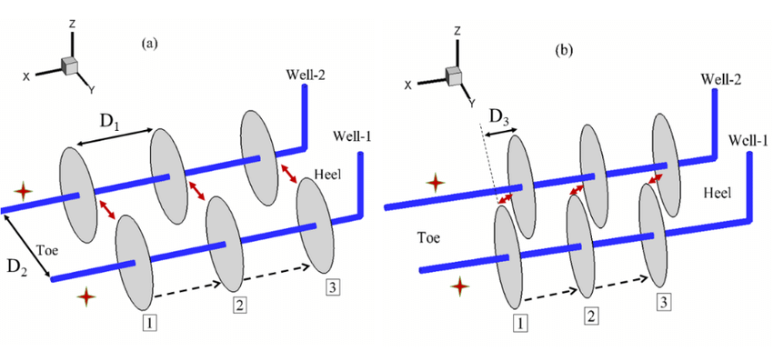
Introduction
The advance in horizontal drilling and hydraulic fracture significantly increase the United States oil and gas production
Operators tries to drill their horizontal wells as close as possible to maximize production.
As a result, hydraulic fracture hits among the horizontal wellbores have become norm.
Frac hits were reported to have positive and negative impacts.

Slide 4
Data Acquisition/Data Wrangling
Data Wrangling
There are 79 hydraulic fracture stages
68,333 LAS files. Each LAS file is 1 second measurement
Each LAS file was loaded into Pandas DataFrames
Filtered out 0-8,000 ft depth
Separated the negative and positive slow strain
Filtered data into pre-frac (5 minutes before the stage starts), during frac and
post frac (after the stage ended to the 5 minutes before the next stage start)

Slide 5
Data Acquisition/Data Wrangling (cont.)
Engineer Features
16 features were computed
Cumulative positive/negative strain pre-frac
Cumulative positive/negative strain during-frac
Cumulative positive/negative strain post-frac
Total strain during-frac
Total strain after-frac
Difference in positive strain between during-frac vs. post-frac
Difference in negative strain between during-frac vs. post-frac
Root-mean-square (RMS) was applied to cumulative positive/negative strain pre-frac, during-frac
post-frac

Slide 6
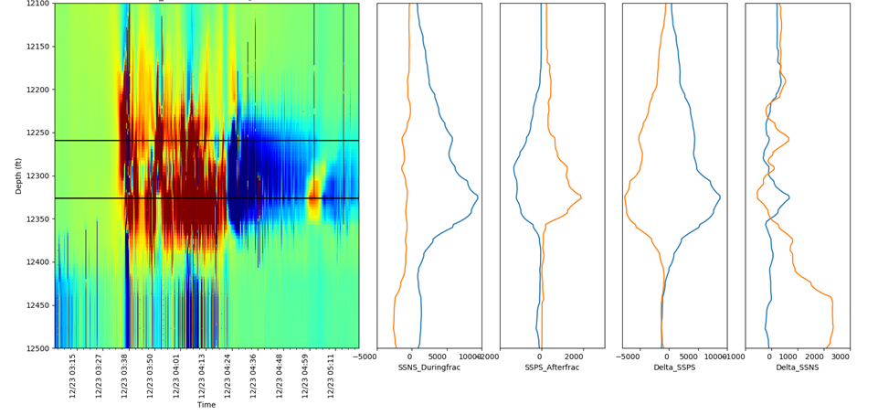
Data Acquisition/Data Wrangling (cont.)
Data Labels
Initially, frac hits labels were picked by
engineers in the field
Highly inconsistent and subjective
Developed a methodology to pick the frac hits
based on the correlation between peaks

Slide 7
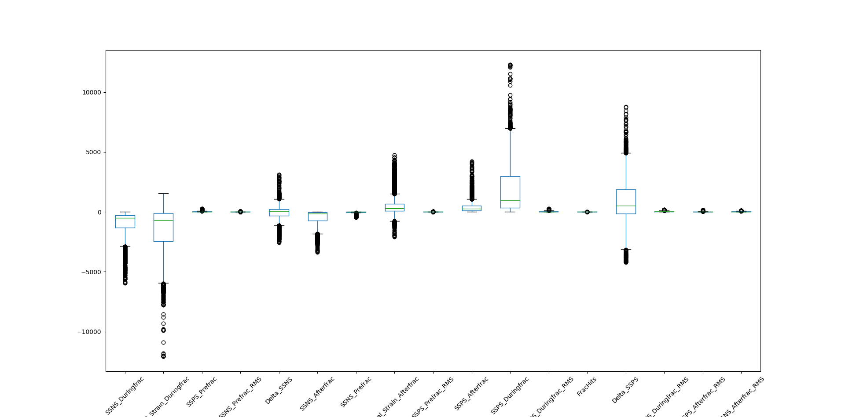
Data Visualization
All the feature data have outliers
Leave outliers as they are because they may reflect the true nature of measurement data

Slide 8
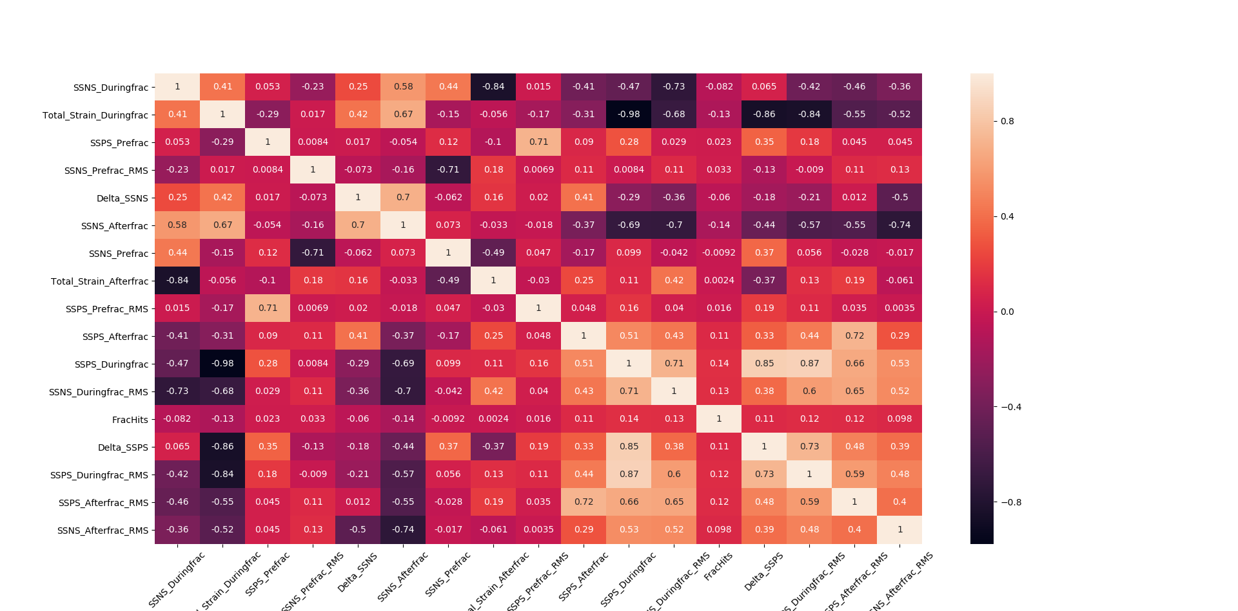
Data Visualization (cont.)
Cumulative negative strain after-frac exhibits negative linear relationship with cumulative positive strain during-frac
Total strain during-frac shows strong correlation with cumulative negative strain after-frac and inverse correlation with cumulative positive strain during-frac and Delta-SSPS

Slide 9
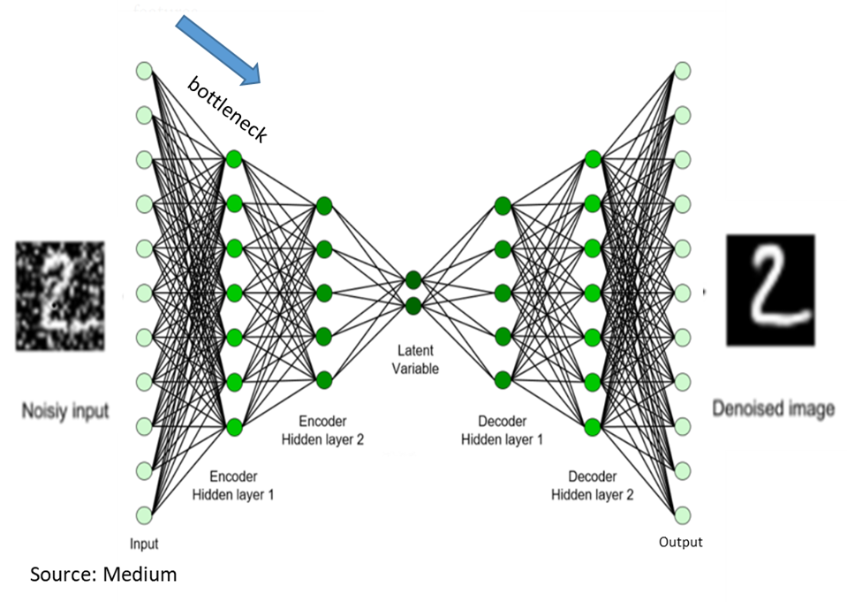
Sparse Autoencoder - Background
Autoencoder is a special type of deep learning, which takes high dimensional input vector and pass it through to hidden layer(s) called encoder to compress the high dimensional input vector to lower dimensional vector. The lower dimensional vector is called latent vector.
The latent vector is then goes through another hidden layer(s) called decoder to create the output vectors, that is very close to the original input vector without the noise.
Note that, the number of neurons in encoder layer(s) is less than input vector’s features to create the bottleneck in the network, so the network is forced to learn the main features of the input vector, not the noise. As a result, the output images from the left showed clearer digit images than the input images.
In this study, sparse autoencoder is used to detect frac hits. Sparse autoencoder is simply an autoencoder in which the bottleneck is created by penalizing activation of hidden layers instead of having fewer neurons than input vector’s features.

Slide 10
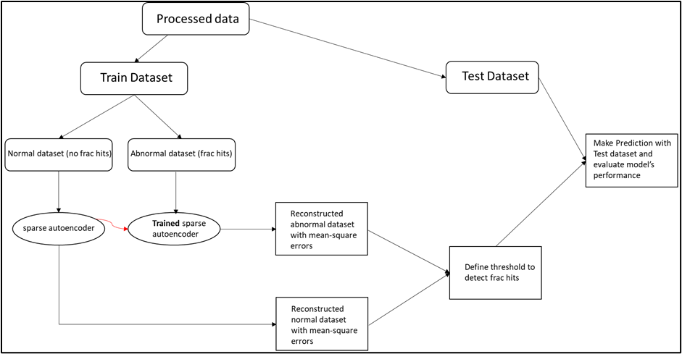
Sparse Autoencoder - Methodology

Slide 11
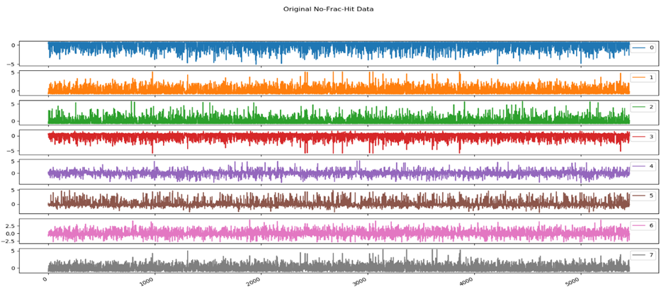
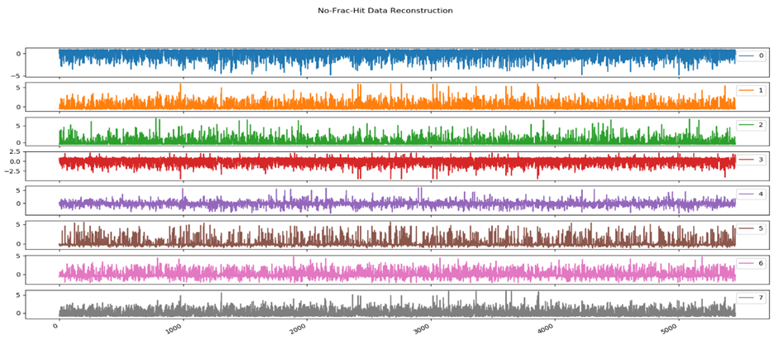
Sparse Autoencoder – Normal Input Data Reconstruction
As shown, the No-Frac-Hit Data Reconstruction resembles many features of original data
Model is efficient to learn the original input data.
Therefore, the MSE between original no-frac-hit data and its reconstruction should be small.

Slide 12
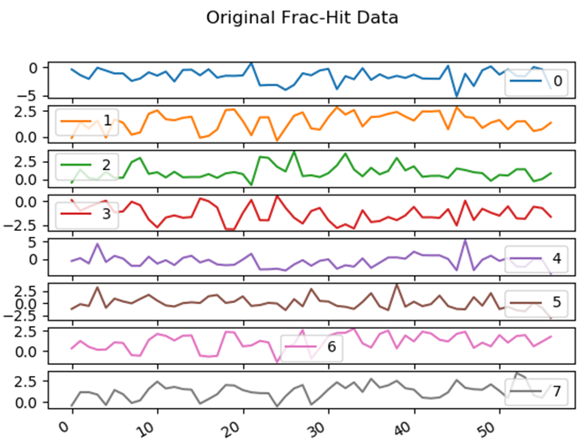
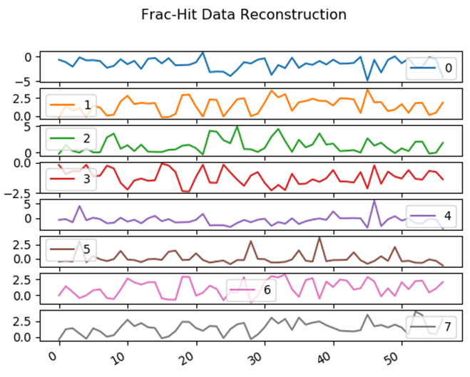
Sparse Autoencoder – Normal Input Data Reconstruction
The Frac-Hit Data Reconstruction shows similar features as original data. However, the magnitudes are different.
Therefore, the MSE between original frac-hit data and its reconstruction should be higher.

Slide 13
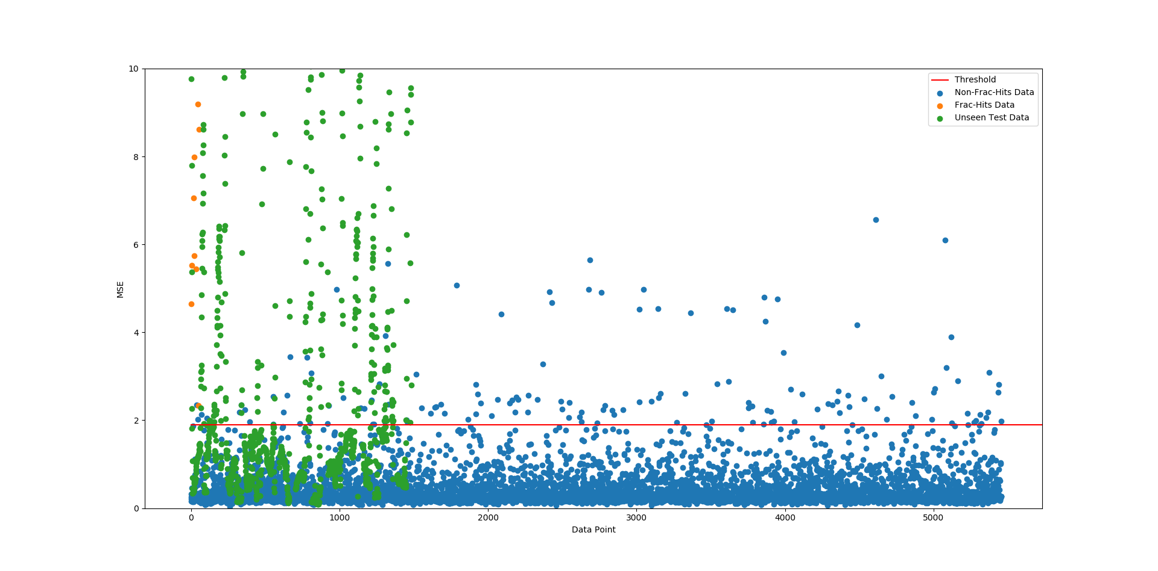
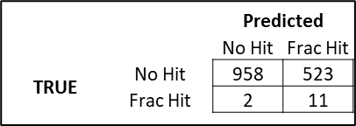
Sparse Autoencoder – Results
A threshold was defined. Any data point that has MSE higher than the threshold will be considered as frac hits.
Any data points below the threshold will be considered as non-frac-hit.
Model can correctly detect 11 frac hits out of 13, which yield 85% accuracy.
It only can detect 958 non-frac hits out of 1481, which yield 65% accuracy.
There is a trade-off of accuracy between frac hit and non-frac hit events.

Slide 14
Conclusions
Sparse autoencoder was developed to detect the frac hit events. With the defined threshold, the model can predict the frac hit events with 85% accuracy.
However, there is a tradeoff between the false alarm vs. the accuracy to detect frac hits. While the model is very efficient to detect the frac hit events, but it can only predict the non-frac hit events with 65% accuracy.
Investigate further to understand why several non-frac hit events exhibits very high MSE.
Future Work
Pursue to develop LSTM autoencoder and other machine learning algorithms to deal with time series data. So, the time of frac hit events can be identified.

